Slide 1
User Interface Design

Slide 2
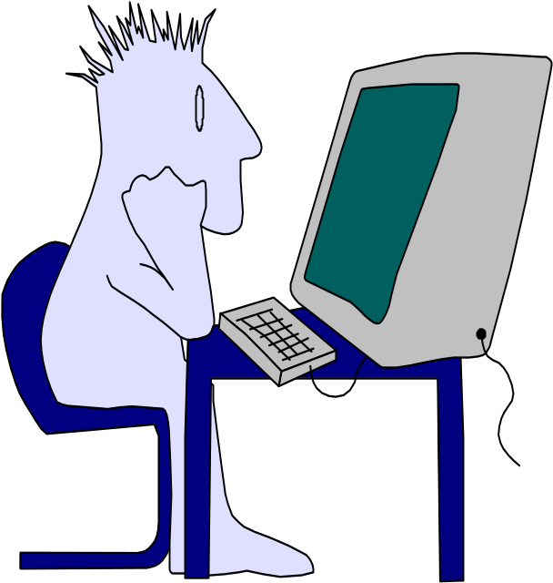
Interface Design
Easy to learn?
Easy to use?
Easy to understand?

Slide 3

Interface Design
Typical Design Errors
lack of consistency
too much memorization
no guidance / help
no context sensitivity
poor response
Arcane/unfriendly

Slide 4
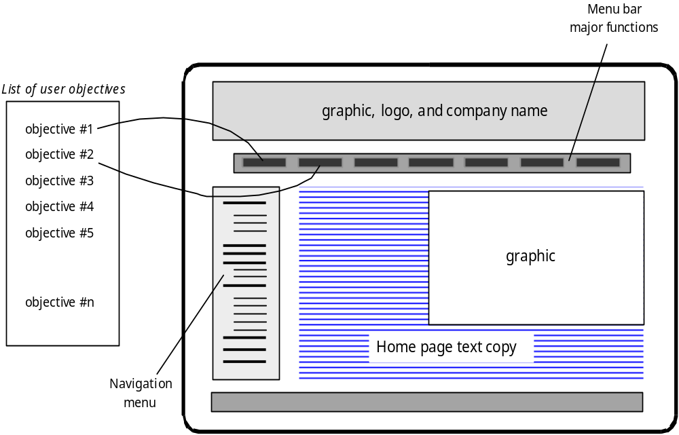
Mapping User Objectives

Slide 5
Golden Rules
Place the user in control
Reduce the user’s memory load
Make the interface consistent

Slide 6
Place the User in Control
“What I really would like,” said the user solemnly, “is a system that reads my mind. It knows what I want to do before I need to do it and makes it very easy for me to get it done. That’s all, just that.”
wanted a system that reacted to her needs and helped her get things done.
User wanted to control the computer, not have the computer control user.
As a designer, you may be tempted to introduce constraints and limitations to simplify the implementation of the interface.
The result may be an interface that is easy to build, but frustrating to use.

Slide 7
Place the User in Control
Define interaction modes in a way that does not force a user into unnecessary or undesired actions.
Provide for flexible interaction(Keyboard, mouse movement , voice).
Allow user interaction to be interruptible and undoable.
Streamline interaction as skill levels advance and allow the interaction to be customized. (macros)
Hide technical internals from the casual user.
Design for direct interaction with objects that appear on the screen (scale in size).

Slide 8
Reduce the User’s Memory Load
Reduce demand on short-term memory.
Establish meaningful defaults.
Define shortcuts that are intuitive.
The visual layout of the interface should be based on a real world metaphor. (Check box, drop down )
Disclose information in a progressive fashion (text style) .

Slide 9
Make the Interface Consistent
Allow the user to put the current task into a meaningful context . Ex: window titles, graphical icons, enable user to know the context of the work at hand.
Maintain consistency across a family of applications.
If past interactive models have created user expectations, do not make changes unless there is a compelling reason to do so.

Slide 10

User Interface Design Process

Slide 11
Interface analysis
Interface analysis focuses on the profile of the users who will interact with the system. Skill level, business understanding, and general receptiveness to the new system are recorded; and different user categories are defined. For each user category, requirements are elicited. In essence, you work to understand the system perception for each class of users.
Once general requirements have been defined, a more detailed task analysis is conducted. Those tasks that the user performs to accomplish the goals of the system are identified, described, and elaborated (over a number of iterative passes through the spiral).
Finally, analysis of the user environment focuses on the physical work environment
  Where will the interface be located physically?
  Will the user be sitting, standing, or performing other tasks unrelated to the interface?

Slide 12
Interface analysis
User Analysis
Are users trained professionals, technician, clerical, or manufacturing workers?
What level of formal education does the average user have?
Are the users capable of learning from written materials or have they expressed a desire for classroom training?
Are users expert typists or keyboard phobic?
What is the age range of the user community?
What is the primary spoken language among users?
What are the consequences if a user makes a mistake using the system?
Are users experts in the subject matter that is addressed by the system?

Slide 13
Interface analysis
Task Analysis and Modeling
Answers the following questions …
  What work will the user perform in specific circumstances?
  What tasks and subtasks will be performed as the user does the work?
  What specific problem domain objects will the user manipulate as work is performed?
  What is the sequence of work tasks—the workflow?
  What is the hierarchy of tasks?
Use-cases define basic interaction
Task elaboration refines interactive tasks
Object elaboration identifies interface objects (classes)
Workflow analysis defines how a work process is completed when several people (and roles) are involved

Slide 14
Interface analysis
Analysis of Display Content
Are different types of data assigned to consistent geographic locations on the screen (e.g., photos always appear in the upper right hand corner)?
Can the user customize the screen location for content?
Is proper on-screen identification assigned to all content?
If a large report is to be presented, how should it be partitioned for ease of understanding?
Will mechanisms be available for moving directly to summary information for large collections of data.
Will graphical output be scaled to fit within the bounds of the display device that is used?
How will color to be used to enhance understanding?
How will error messages and warning be presented to the user?

Slide 15
Interface design
The goal of interface design is to define a set of interface objects and actions (and their screen representations) that enable a user to perform all defined tasks in a manner that meets every usability goal defined for the system.
1.Define interface objects and actions (operations).
2. Define events (user actions) that will cause the state of the user interface to change. Model this behavior.
3. Depict each interface state as it will actually look to the end user.
4. Indicate how the user interprets the state of the system from information provided through the interface.

Slide 16
Interface construction
Interface construction normally begins with the creation of a prototype that enables usage scenarios to be evaluated. As the iterative design process continues, a user interface tool kit may be used to complete the construction of the interface.

Slide 17
Interface validation
Interface validation focuses on (1) the ability of the interface to implement every user task correctly, to accommodate all task variations, and to achieve all general user requirements; (2) the degree to which the interface is easy to use and easy to learn, and (3) the users’ acceptance of the interface as a useful tool in their work.

